Slide 1
Grammatical gender processing in L2 speakers of Spanish
Does cognate status help?
Does gender transparency enhance processing?
Lauren Perrotti & Nathan Hollister

Slide 2
Introduction
The purpose of this research is to investigate the spoken-word processing of grammatical gender in English-Spanish bilinguals using eye-tracking
This study will investigate whether or not it is modulated by cognate status or gender transparency

Slide 3
Preliminary findings
English-Spanish bilinguals do not generally use grammatical gender in articles to facilitate the processing of upcoming nouns as native speakers do
Lew-Williams and Fernald (2010)
Head Turning Preference Paradigm
Low proficiency
Age level (M=18.8 yrs)
Word type
Overgeneralized

Slide 4
Cognates
Cognates are words that share form and meaning between languages
guitar and guitarra
Research shows that cognates are easy to learn
Results have shown that cognates behave differently than non-cognates

Slide 5
Research Questions
Can native English speakers — who are highly proficient speakers of Spanish, and who have demonstrated mastery of the Spanish grammatical gender system in production — use grammatical gender in Spanish to facilitate the processing of nouns as native Spanish speakers do, i.e. anticipatory effects (Lew-Williams & Fernald, 2007)?

Slide 6
Research Questions
Is the grammatical gender of cognates and/or transparent nouns easier to access?
Cognate vs Non-cognate
Transparent vs Opaque

Slide 7
Participants
English-Spanish, highly proficient bilinguals from the Department of Spanish, Italian, and Portuguese at Penn State University
Data will be collected in the fall of 2011
Native Spanish speakers from the Universidad de Granada
60 monolingual participants

Slide 8
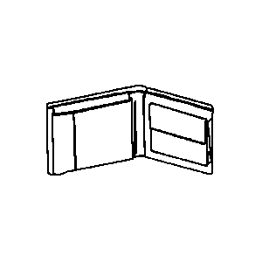
Materials
Pictures
Line drawings proved insufficient
Difficult to recognize
Not enough of quality
Real pictures
Less limitation
Normed for naming agreement by picture naming

Slide 9
Materials
Word List and Picture Controls
Tangible items to picture
Gender transparency
Cognate status
Frequency
Plurality /collective nouns (e.g. chalk, people)

Slide 10
Materials
Participants will be played an audio recording of the carrier phrase
Encuentra el/la___________ while presented with a 2-picture display
One of the 2 items presented on the computer screen will be named in the carrier phrase
Recordings
Average of 10 recordings for article duration
Article is time locked to verb- timestamp of the occurrence of the article is known
2 parts: “encuentra el/la” + noun
Avoid information of noun onset influencing the article

Slide 11
Method
Participants will hear an auditory command and will be asked to click on the corresponding image on a computer screen
Eye-tracking equipment will record all eye movements and duration
We predict hearing the definite article before hearing the noun itself will cause the participant to anticipate and execute preliminarily looks at the target image

Slide 12
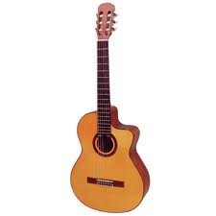
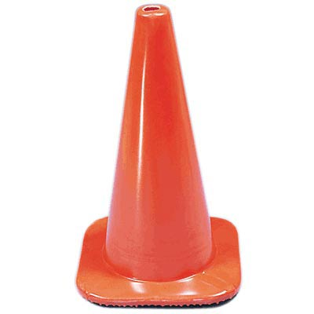
Method

Slide 13
Method
Images
Masculine-Masculine
Feminine-Feminine
Masculine-Feminine
Cognates are always paired with cognates
Transparent words are always paired with transparent words

Slide 14
Predictions
Potentially, there are classes of words or morphophonological features that permit ease of processing, e.g. cognates and transparency
If the gender is being using anticipatorily, then we should see it in these classes of words (cognates and transparent nouns)
For monolinguals, we expect no difference for the cognate manipulation; however, there may be a faster anticipatory effect for transparency

Slide 15
Eye-tracking: The visual world paradigm
The EyeLink 1000 measures
Fixation point of a participant
Duration with which he views an object
A video camera records eye movements
Infrared light reflects off the cornea of the eye
Eye movements can be time-locked to the presentation of auditory material

Slide 16
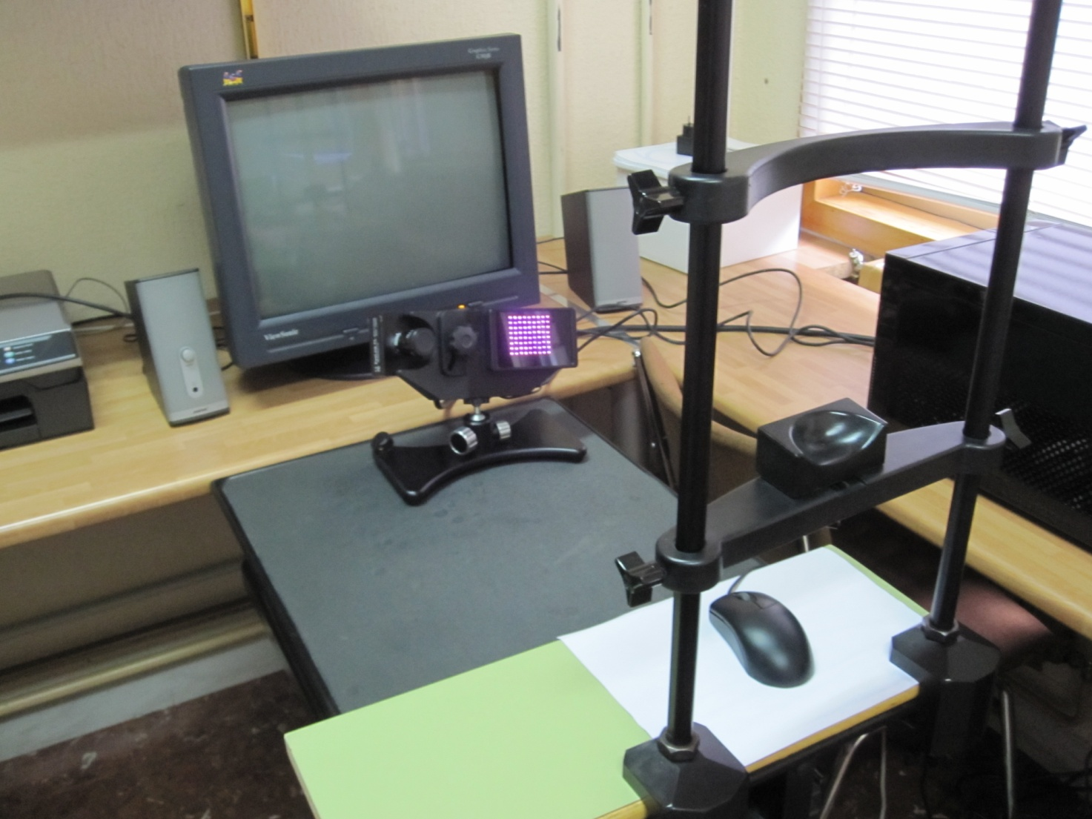
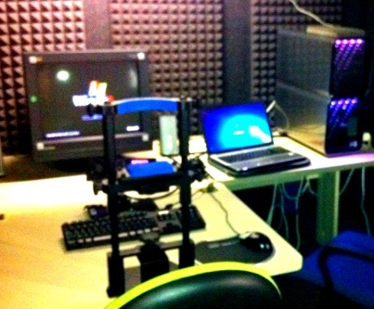
Eye-tracking: The visual world paradigm
¡Gracias por compartir 382!
Eyelink 1000
1
Computer screen where pictures appear
Chin rest
Eye-tracker
Computer mouse
Participant’s chair
1
2
2
3
3
4
4
5
5

Slide 17
Behavioral Tasks
Tasks
Language History Questionnaire
O-Span
Lexical Decision Task
Picture Naming
Spanish Proficiency- Grammar Test
Notes:
We included a number of tests to measure proficiency in a couple of different ways, using different methods

Slide 18
Partnerships for International Research and Education (PIRE)
Collaboration
Universidad de Granada
Pennsylvania State University
Allows us to broaden our study
Control group – L1 Spanish speakers
Using our materials and method here, we’re hoping to find that native speakers:
Use grammatical gender in articles to anticipate nouns
No preference to cognate status, but possibly a faster anticipatory effect for transparency

Slide 19
Significance
Highly proficient bilinguals
Use grammatical gender to anticipate nouns
New method
Visual world paradigm to investigate processing speed
The dependent measure is not an action
Measuring eye movements

Slide 20
Significance
Facilitate processing
Nouns with transparent gender
Cognates
Easily committed to memory
No rule to apply
However, it is possible that it can engage both languages, employing conflicting information

Slide 21
Thank you!
Giuli Dussias ∙ Jorge Valdes
Chip Gerfen ∙ Jason Gullifer
Teresa Bajo ∙ James Graham
Center for Language Sciences at Penn State
Universidad de Granada
- Facultad de Psicología
Partnerships for International Research and Education (PIRE)
Funding provided by NSF BCS 0821924 grant to Paola Dussias and Chip Gerfen and by NSF OISE 0968369 PIRE grant
¡Gracias!

